Slide 1

Identifying marketing investment efficiencies
Study name
LIFT ROI
Fecha

Slide 2

Agenda
Project status
Scope / Objectives
Timeline and next steps
Category overview
3. Brand focus
Media deep dive

Slide 3
1
Project status

Slide 4





Objective
Understand the impact of marketing efforts in sales and/or brand equity.
For that, we decompose sales volume and/or measured brand equity results, isolating the effects of each marketing effort to understand their individual effects.
Direct impact in
LiftROI Model
Sales
Equity
Input:
XX years of monthly/weekly data:
Brand sales, distribution and average price.
Media investment and media activity results (TV, OOH, Digital, etc.)
Other marketing efforts (owned media activity, innovations, promotions, etc.)
Macroeconomic variables

Slide 5
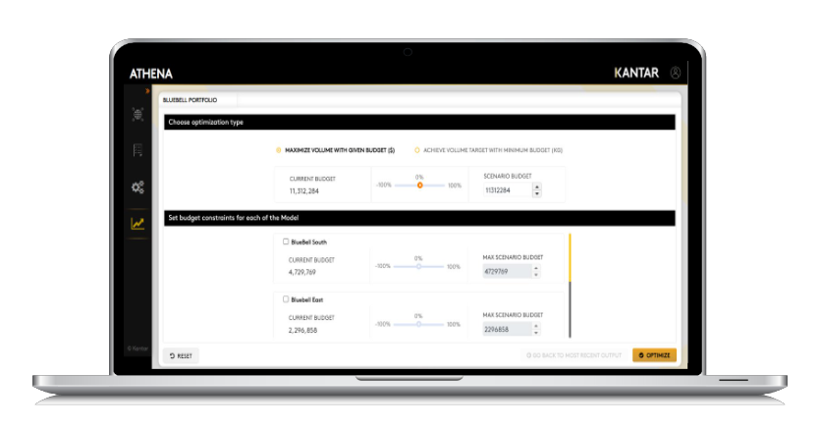
At the end, we’ll have the following results:
Illustrative
1. Sales decomposition / Equity decomposition
2. Incremental volume for each individual effort
1,280
X
1,080
Facebook
880
Search
680
Ventas / Equity
480
Banner
280
YouTube
80
Tiempo
3. ROI and saturation curves
4. Optimization
ROI | 2.8 | 3.4

Slide 6






Timeline
Average execution time since Kick Off ~ 17 weeks
Scope check |  | Data check | Insights check
1. Model design | 2. Data collection | 3. Data sign off | 4. Modelling | 5. Final report | 6. Simulations
Kick-off call | Data collection and validation | Data sign off for modelling | First presentation of model results | Final report delivery | Simulations
Scope Contact mapping | Data descriptives and variables transformations | Descriptives presentation to client Data sign off from client Data lockdown for modelling | Base presentation Contributions Preliminary checks | Final presentation Contributions ROI Saturation curves | Simulation scenarios for media planning
Week 0 | Week 1-3 | Week 4 | Week 5-11 | Week 17 | From week 17
%m-%d-%Y | %m-%d-%Y | %m-%d-%Y | %m-%d-%Y | %m-%d-%Y | %m-%d-%Y

Slide 7
Model technical spec (1/2)
Category: xxx
Brand: xxx
Period: xxx
Frequency: xxx
Analysis breaks: xxx
Coverage: xxx
Sales channel: xxx
Dependent variable: xxx

Slide 8
Overall sales volume contribution

Slide 9
Media sales volume contribution

Slide 10
Media sales volume contribution

Slide 11
Contribución de medios vs contribución total en volumen ###PIMPEAR###

Slide 12
Inversion en medios vs contribución en volumen

Slide 13
Media performance analysis

Slide 14
Media ROI

Slide 15
Campaing contribution and ROI
 | 23' Camp Volume | 24' Camp Volume | No Campaign Volume | 23' Camp Revenue | 24' Camp Revenue | No Campaign Revenue | 23' Camp ROI | 24' Camp ROI | No Campaign ROI
Media Digital Display | 1,054.24 | 0.00 | 0.00 | 96,765,546.67 | 0.02 | 0.06 | 5.27 | 0.00 | 0.00
Media Digital YT+Meta | 2,147.61 | 2,089.36 | 0.00 | 198,765,016.17 | 201,744,898.31 | 0.08 | 3.97 | 1.47 | 0.00
Media OOH Retail | 746.11 | 571.83 | 0.00 | 69,650,944.54 | 55,025,906.14 | 0.01 | 3.54 | 1.78 | 0.00
Media OOH Screen | 1,227.36 | 0.00 | 0.00 | 113,636,955.37 | 96.86 | 0.05 | 2.49 | 0.00 | 0.00
Media Search Google | 383.08 | 200.02 | 0.00 | 35,050,143.16 | 19,393,112.78 | 0.04 | 5.00 | 2.82 | 0.00

Slide 16
Due to's - FY'23

Slide 17
Due to's - FY'24

Slide 18
Full media comparison

Slide 19
Saturation curve – Media Digital Display

Slide 20
Saturation curve – Media OOH Retail

Slide 21
Saturation curve – Media Digital YT+Meta

Slide 22
Saturation curve – Media OOH Screen

Slide 23
Saturation curve – Media Search Google

Slide 24
Saturation curves thresholds
 | Breakthrough | Full Saturation | Maximum ROI | Start of Saturation | Current Average
Media Digital Display | 42,160 | 257,040 | 170,000 | 190,400 | 1,177,647
Media Digital YT+Meta | 3,354,606 | 45,287,184 | 22,044,555 | 33,546,063 | 38,520,675
Media OOH Retail | 5 | 15 | 10 | 12 | 36
Media OOH Screen | nan | nan | 43 | nan | 153
Media Search Google | 1,687 | 10,044 | 4,982 | 6,026 | 16,942

Slide 25
Media optimization - Media Digital Display
ROI
Effectiveness
CPA
 | Breakthrough | Full Saturation | Maximum ROI | Start of Saturation | Current Average
Media Digital Display | 42,160.00 | 257,040.00 | 170,000.00 | 190,400.00 | 1,177,647.33

Slide 26
Media optimization - Media OOH Retail
ROI
Effectiveness
CPA
 | Breakthrough | Full Saturation | Maximum ROI | Start of Saturation | Current Average
Media OOH Retail | 5.31 | 14.75 | 9.83 | 11.60 | 35.99

Slide 27
Media optimization - Media Digital YT+Meta
ROI
Effectiveness
CPA
 | Breakthrough | Full Saturation | Maximum ROI | Start of Saturation | Current Average
Media Digital YT+Meta | 3,354,606.26 | 45,287,184.50 | 22,044,555.42 | 33,546,062.59 | 38,520,674.71

Slide 28
Media optimization - Media OOH Screen
ROI
Effectiveness
CPA
 | Breakthrough | Full Saturation | Maximum ROI | Start of Saturation | Current Average
Media OOH Screen | nan | nan | 42.91 | nan | 153.37

Slide 29
Media optimization - Media Search Google
ROI
Effectiveness
CPA
 | Breakthrough | Full Saturation | Maximum ROI | Start of Saturation | Current Average
Media Search Google | 1,687.36 | 10,043.78 | 4,981.72 | 6,026.27 | 16,942.33

